Slide 1

HRA Meeting
January 5th 2026

Slide 2
INTRODUCTIONS
INTERIM Committee:
Chair -John Greenhalgh
Treasurer – Sarah Palios
IT – Joe Corrall
Secretary – Sharon Lewis
Notes:
Dartmoor, Simon and Keith unable to be members

Slide 3
LOCAL COUNCILLORS
Karl Brockett - HTC Hinchingbrooke Park ward
David Landon Cole - Huntingdon Town Council – Planning Chair
Patricia Jordan - Brampton ward includes Hinchingbrooke Park
Tom Sanderson - HDC, HTC, CCC
Dave Shaw – Brampton ward includes Hinchingbrooke Park

Slide 4
VISITORS
Lynne Pinn - Brampton Cross Working Group & Alconbury Parish Council
Chip Colquhoun - Brampton PC
Other parish councillors
Friends of Country Park

Slide 5
HINCHINGBROOKE RESIDENTS’ ASSOCIATION –Background
Flyer – September 25
Meetings – 20/10/25 & 8/12/25
Interim Committee agreed
Purpose – ensure consulted about anything that affects lives on the estate (developments, traffic delays)
Recognise value of appropriate developments

Slide 6
Process to form HRA and dates - Sarah
Process to form HRA
Inaugural AGM - Monday 2nd February 2026 at The George Hotel
  (residents notified via website)
HRA Constitution
  (to be published on website)
HRA Committee
  (voted in at AGM)

Slide 7
Funding
Need to cover HRA running costs such as printing, website, venue hire
Membership fees - (suggest £5 per member payable voluntarily for the first year to encourage membership uptake)
Donations
  (Gratefully received from residents and supporters)
Application for any available Grant monies
  (HRA Committee to action)

Slide 8
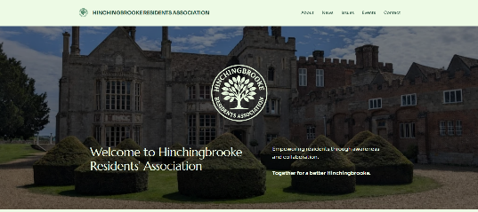
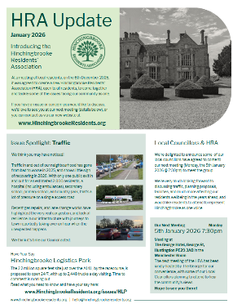
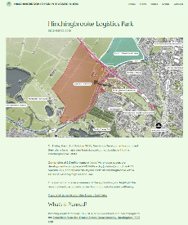
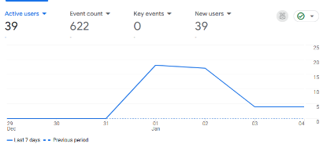

Flyer & Website – Joe
https://hinchingbrookeresidents.org
hello@hinchingbrookeresidents.org
10 responders to HLP survey
3 general messages

Slide 9
HRA STRATEGY
Brampton Cross (BX) involved many Parish Councils
BX wrote letters and copied influential players eg MP, Mayor
We need to enlist support of others as wide a group as possible
Impact on Daily Lives
We can’t change past decisions, but we can affect future

Slide 10
HLP – Newlands Outline Planning Application
2m sq ft ; 1m sq ft pre-sold
13 warehouses 24m, 21m & 18.5m high
24/7 operation
Roundabout by Marriott
Underpass – Is toucan crossing better?
A141 re-aligned
£9.8m Business Rates for HDC per Newlands (was £4m)

Slide 11
HLP
3,300 jobs per Newlands (was 2,000)
Friends of Hinchingbrooke Country Park met Newlands & wrote letter
Alconbury Flood Group – identified need for more flood prevention
Cycle path
HTC meeting October – HTC wrote letter with their issues
HLP development aim to be complete 2027

Slide 12
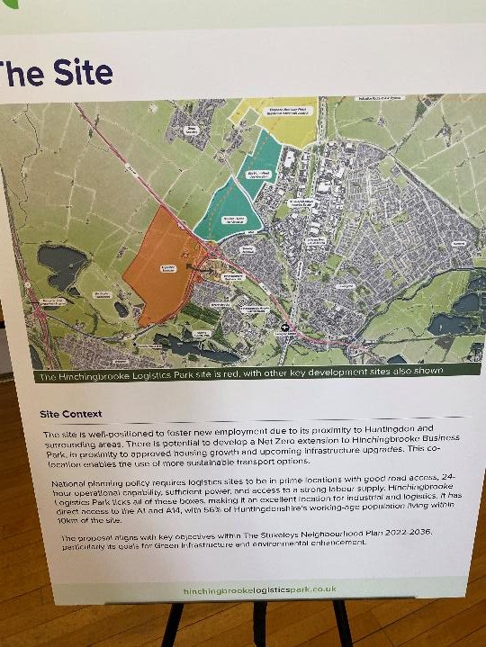

Slide 13
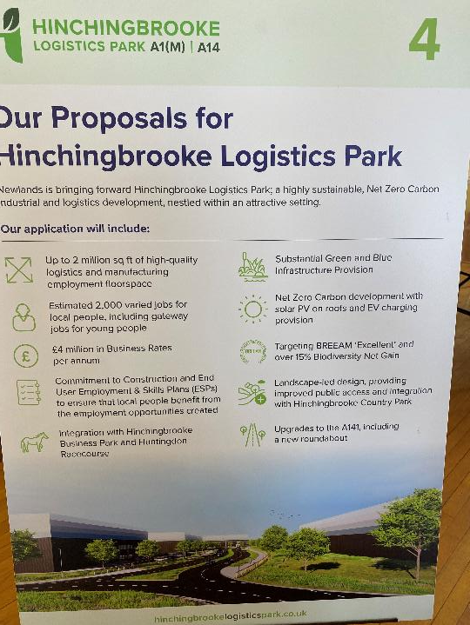

Slide 14
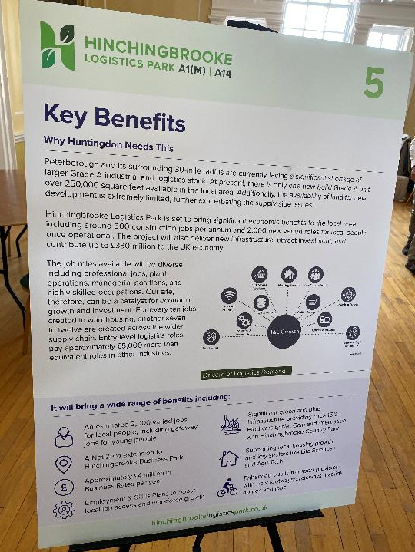

Slide 15
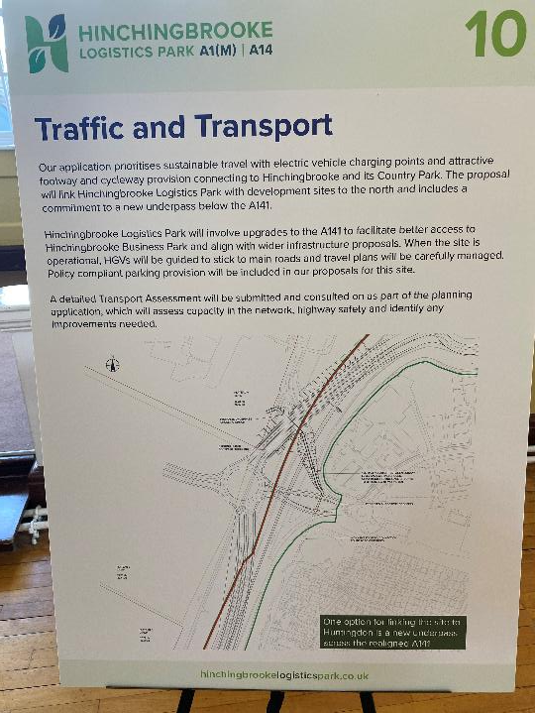

Slide 16
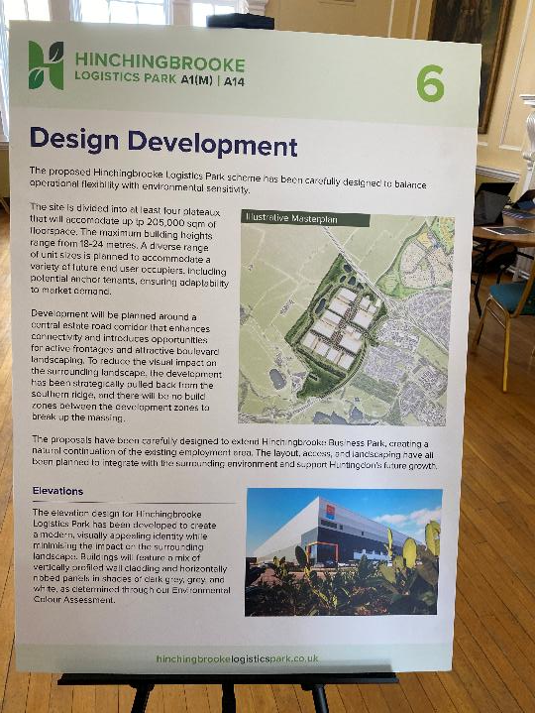

Slide 17
HDC process
25/01922/ OUT on HDC planning portal
235 documents – some very long
35 letters sent objecting to HLP
Hunts Post – Alconbury Parish Council comments v. helpful
Newlands active Facebook campaign

Slide 18
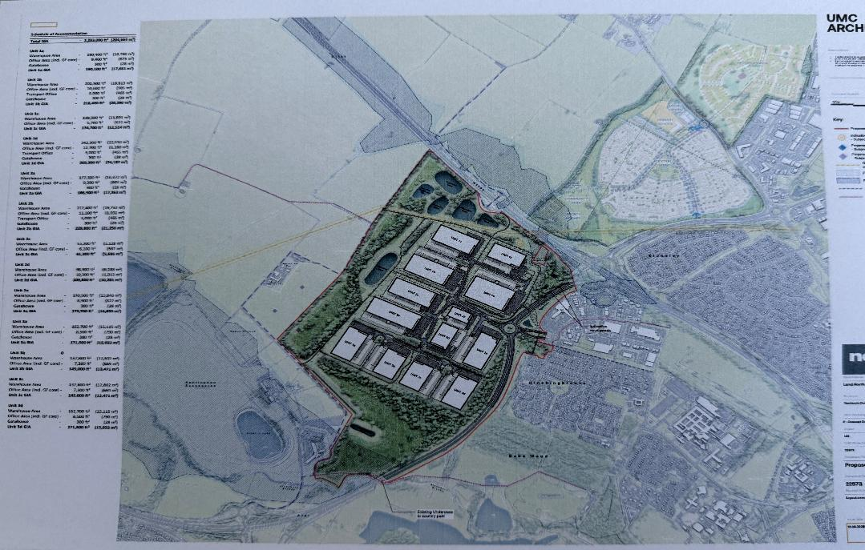

Slide 19
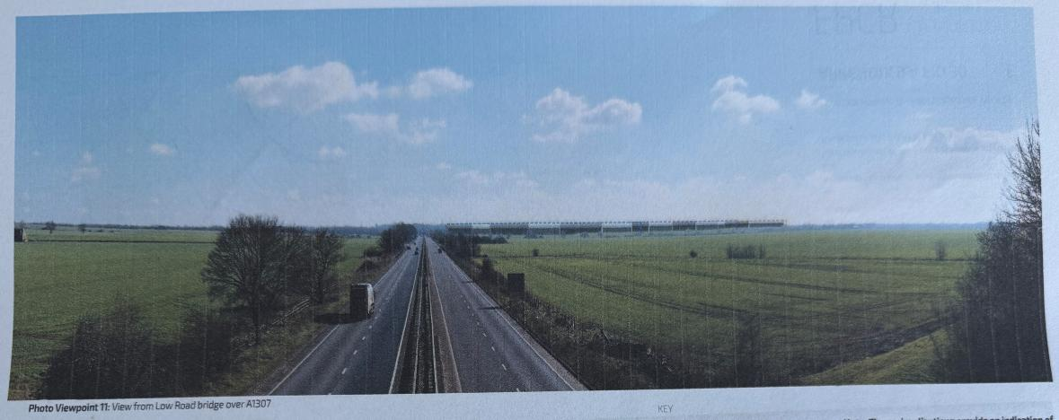

Slide 20
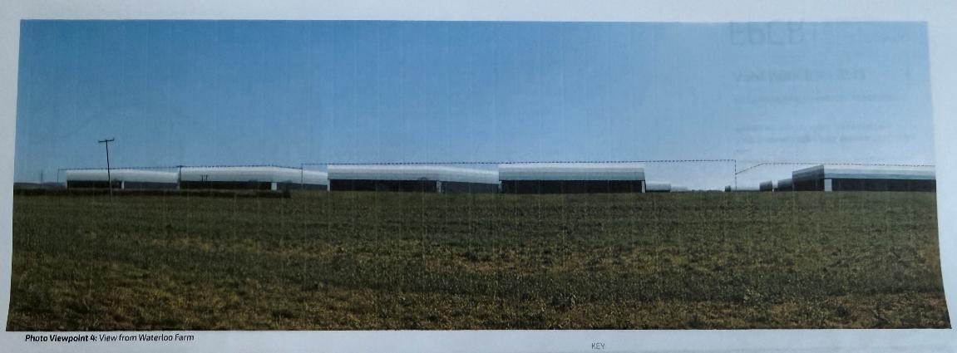

Slide 21
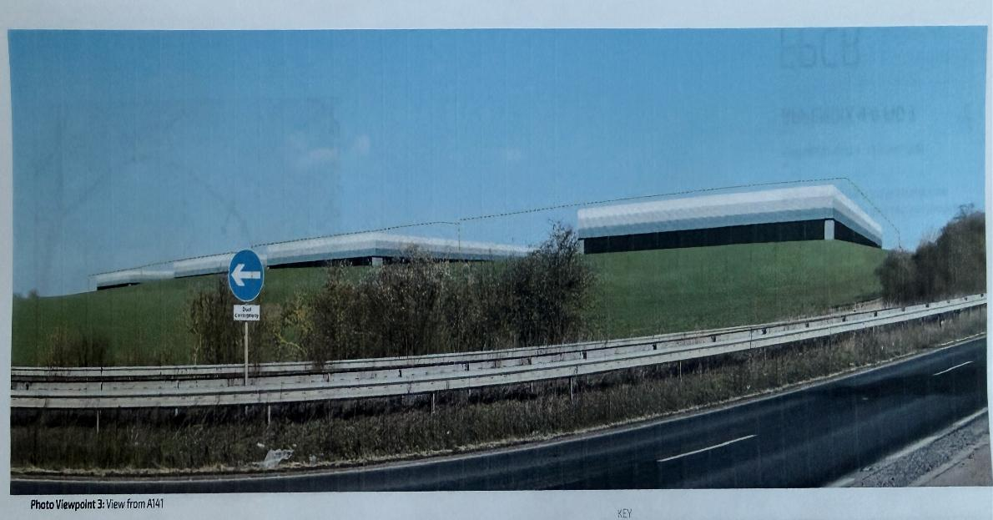

Slide 22
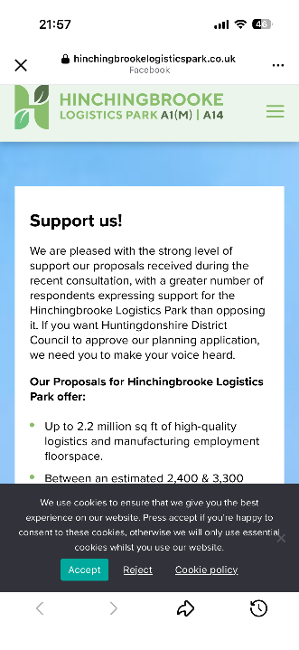

Slide 23
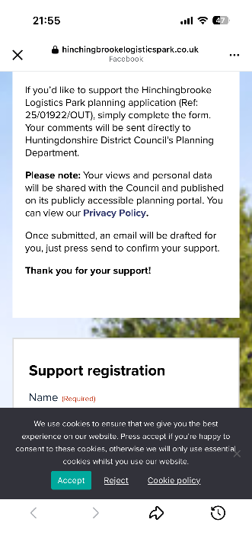

Slide 24
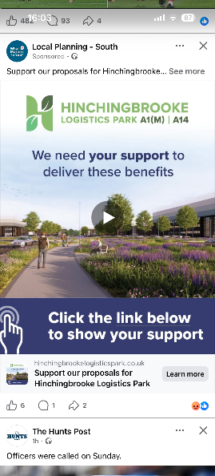

Slide 25
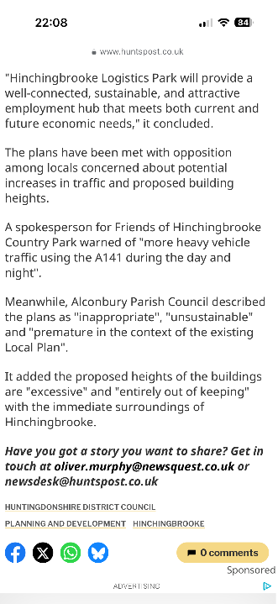

Slide 26
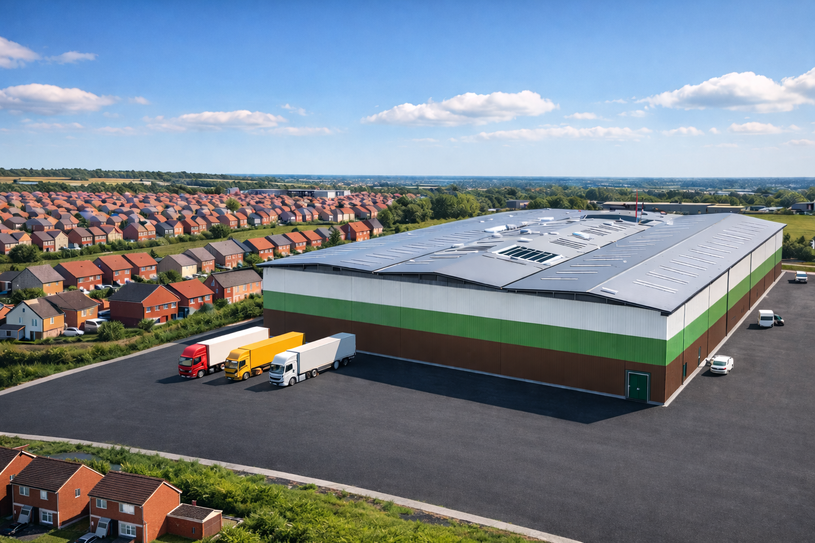

Slide 27
HDC DECISION PROCESS
Development Management Committee – likely 16/2/26 (or 16/3)
DMC receive a report from planning officer with recommendation
DMC members decide
16 Councillors on DMC (inc Tom Sanderson & Patricia Jordan)

Slide 28
HLP CONCERNS
Warehouse Height
Hours of operation
Traffic
Roundabout
Underpass
Flooding
Pollution
Environment including lighting & noise
Cycle path route

Slide 29
CONCERNS cont
Blakelands MK – no operation between 9pm and 7am
Clear height 15m considered standard for new designs
Heights of 18m & even 21m becoming more common to maximise storage volume without increasing building's footprint (AI)

Slide 30
DRAFT LOCAL PLAN TO 2046
Draft local plan proposed a North Huntingdon growth cluster - an area that includes:
Weybridge farm (between Brampton Hut and Alconbury where Brampton Cross is proposed)
Huntingdon Logistics Park
Ermine Street (between Spittals and Great Stukeley where Bloor Homes are building 1,000 homes)
Land north east of Ermine Street behind business park where Nokia was with a further 648 homes
Expansion of Alconbury Weald with 6,500 homes and a 150ha enterprise zone
A proposed new development called Sapley Garden Village which might have 7,000 homes and
At RAF Wyton 4,000 homes proposed and 15ha proposed for commercial and industrial use.

Slide 31
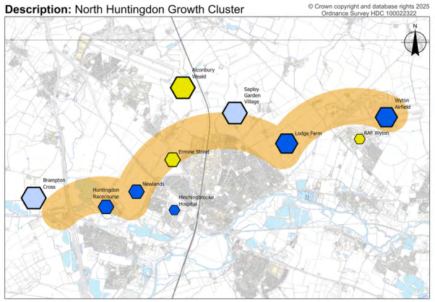

Slide 32
DRAFT LOCAL PLAN TO 2046
Growth cluster (chapter 9) will result in huge increase in traffic heading for Spittals
A14 viaduct removal at station means traffic using a major dual carriageway now uses a single carriageway Increasing the likelihood of significant traffic jams on HPR
Local plan also includes:
New hospital which includes step down accommodation (page 258)
Proposed car parking for the country park off Huntingdon Road (page 292)
Unclear how this fits with Active Travel Plan to reduce width of Huntingdon Road
https://www.huntingdonshire.gov.uk/planning/local-plan-update/preferred-options

Slide 33
TRAFFIC REVIEW
Data provided by CCC to Stantec
Traffic at HPR/ VCR not modelled as no development traffic passing through
Ignores future developments
Accidents at VCR / HPR –data underestimated
Own transport study
Effect of Viaduct removal over Railway bridge ignored
Spittals

Slide 34
Groundhog Day
In 2016 Maurice Dixon produced a report highlighting options to relieve traffic issues on the estate (Lidl 2015, Aldi 2016, VCR 2021)
Maurice sent report to hospital and DMC Chair (Barbara Boddington)
2019 Tom S sent letter to Traffic Safety Officer suggesting link from Parkway to the A141
Unclear what happened – but nothing changed
10 years on – problems getting worse

Slide 35
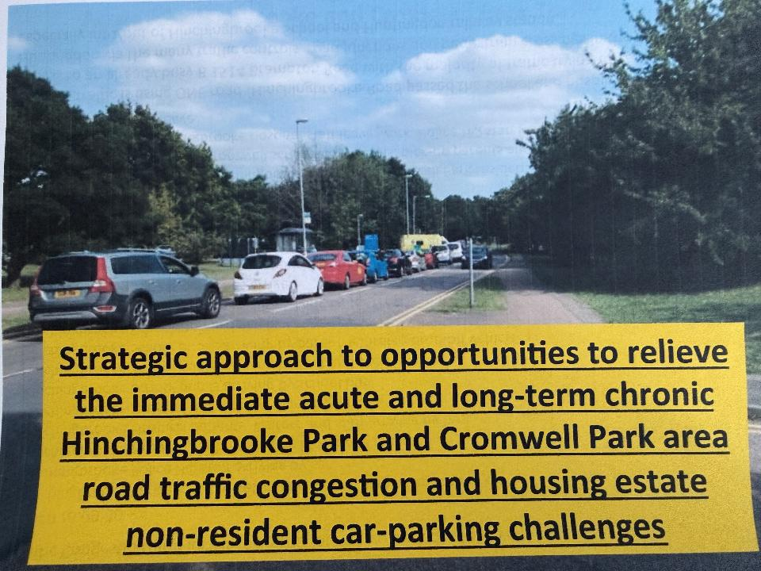

Slide 36
Traffic on estate
Keith & I met Dan from CCC with Tom S on 4/12/25
Invited to meeting with Tom, CCC & Police on 13/1/26
Next Steps – Local Councillors, HDC, CCC, MP, Press
The Council must come up with a solution that residents agree with

Slide 37
ACTIONS NEEDED
Respond to Newlands revisions of 22/12/25 by 28/1/26 (19/1/26 )
Comments / Letters by 28/1/26 to Development Control
Friends / family delayed by traffic can write – detail how affected
Copy HRA in so we can collate and present summary
Concerns in brief – top 5 points by e-mail by 9/1/26
Next Steps – after discussion on traffic

Slide 38
Register Letters with HDC
Letter – include name & address by 19/1/26 (or 28/1/26)
Effect of traffic issues on estate on daily life – tell your personal story
VCR & HPR junction at max capacity – not a traffic light issue
HLP adds to traffic
Issues that concern you –make it personal e.g.
Warehouse Height, Hours of operation, Roundabout
Underpass, Flooding, Pollution
Environment including lighting
Send to Development Control
Copy DMC members, Councillors, MP, Mayor, CPCA, HRA
If already sent letter please send to above people

Slide 39
ACTIVE TRAVEL PLAN - BRAMPTON ROAD
Brampton Road width reduced so vehicles can only travel in single file
Layby by HBK school on Brampton Road would be removed
Cars entering HPR from Brampton unable to go on inside of vehicles
Several Toucan crossings between Brampton Roundabout & station
Unclear what problem the Active Travel proposals are trying to resolve
Revised proposals expected in 2026
https://www.cambridgeshire.gov.uk/residents/travel-roads-and-parking/active-travel-in-cambridgeshire/projects-and-plans/infrastructure-delivery

Slide 40
Actions Suggested
Invite MP to next meeting
HTC meeting & presentation from Newlands
Press

Slide 41
AOB
General Discussion
Date of Next Meeting

